Slide 1
Introduction to Software Engineering
Software Process Model
Muhammad Nasir
m.nasir@iiu.edu.pk

Slide 2
Outline
Build and Fix Model
Why Models are needed?
  Process as a "black box“ & Problem
  Process as a “white box“ & Advantage
Prescriptive Model
Waterfall Model or Linear Sequential
Incremental Process Models

Slide 3
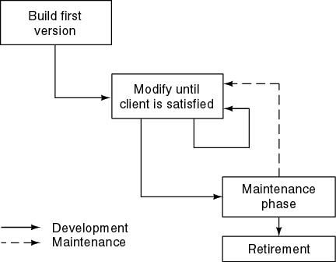
Build and Fix Model

Slide 4
Build and Fix Model
The earlier approach
Product is constructed without specification or any attempt at design.
Developers simply build a product that is reworked as many times as necessary to satisfy the client.
Model may work for small projects but is totally unsatisfactory for products of any reasonable size.
Maintenance is high.
Source of difficulties and deficiencies
  impossible to Predict
  impossible to Manage

Slide 5
Why Models are needed?
Symptoms of inadequacy: The Software Crisis
  Scheduled Time and Cost Exceeded
  User Expectations Not Met
  Poor Quality

Slide 6
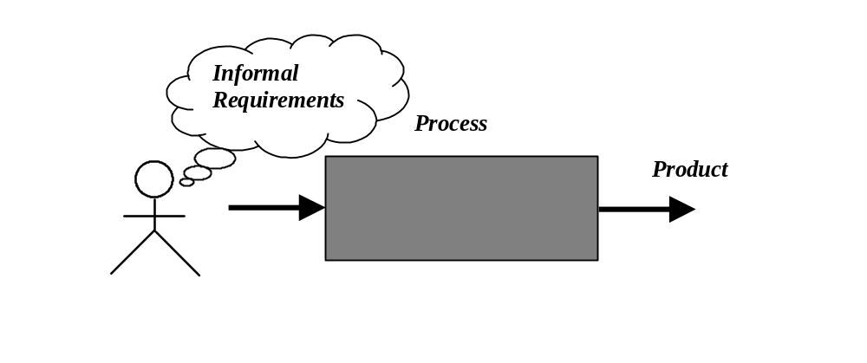
Process as a "black box"
Quality?
Uncertain /
Incomplete requirement
In the beginning

Slide 7
Problems
The assumption is that requirements can be fully understood prior to development
Interaction with the customer occurs only at the beginning (requirements) and end (after delivery)
Unfortunately the assumption almost never holds true

Slide 8
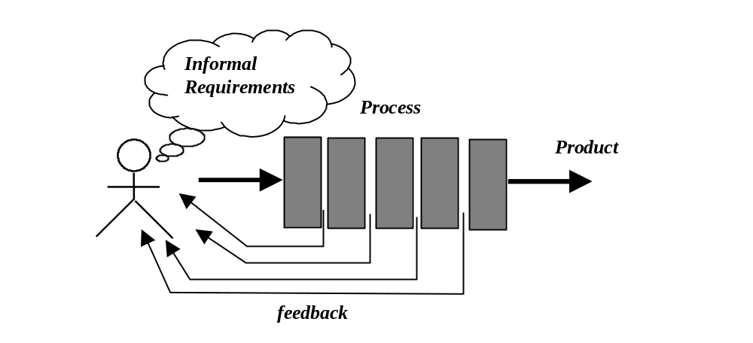
Process as a "white box"

Slide 9
Advantages
Reduce risks by improving visibility
Allow project changes as the project progresses
  based on feedback from the customer

Slide 10
Prescriptive Model
Prescriptive process models advocate an orderly approach to software engineering
Organize framework activities in a certain order
Process framework activities with set of software engineering actions.
Each Task identifies the work to be accomplished to meet the goals.

Slide 11
Prescriptive Model
Software engineer choose process framework that includes activities like;
  Communication
  Planning
  Modeling
  Construction
  Deployment

Slide 12
Prescriptive Model
Calling this model as “Prescribe” because it recommend a set of process elements, activities, action task, work product & quality.
Each element is inter-related to one another (called workflow).

Slide 13
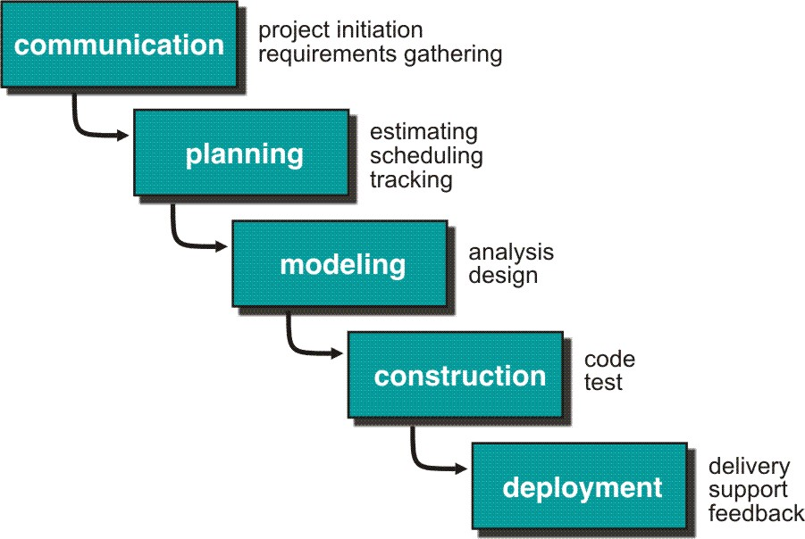
Waterfall Model or Classic Life Cycle

Slide 14
Limitations of the waterfall model
The model implies that you should attempt to complete a given stage before moving on to the next stage
Does not account for the fact that requirements constantly change.
It also means that customers can not use anything until the entire system is complete.

Slide 15
Limitations of the Waterfall Model
Some teams sit ideal for other teams to finish
Therefore, this model is only appropriate when the requirements are well understood, and changes will be fairly limited during the design process.

Slide 16
Waterfall Model - Problems
Problems:
Real projects rarely follow the sequential model.
Difficult for the customer to state all the requirement explicitly.
Assumes patience from customer - working version of program will not available until product is complete.

Slide 17
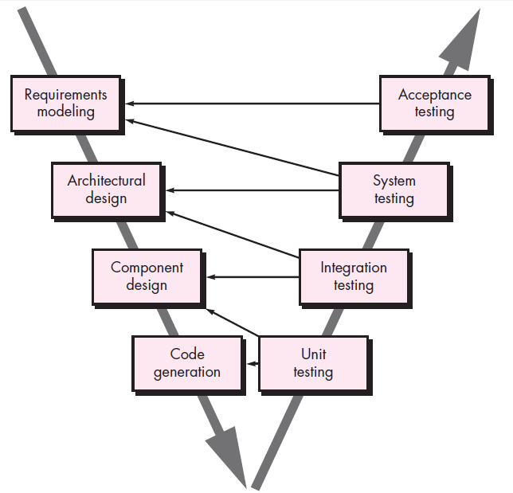
V-Model
Notes:
Acceptance Testing is a test conducted to determine if the requirements specified or in contract are met.

Slide 18
V-Model
V-model depicts the relationship of quality assurance actions to the Frame Work Activities.
In reality, there is no fundamental difference between the classic life cycle and the V-model.
The V-model provides a way of visualizing how verification and validation actions are applied to earlier engineering work.
Notes:
The distinction between the two terms is largely to do with the role of specifications. Validation is the process of checking whether the specification captures the customer's needs, while verification is the process of checking that the software meets the specification

Slide 19
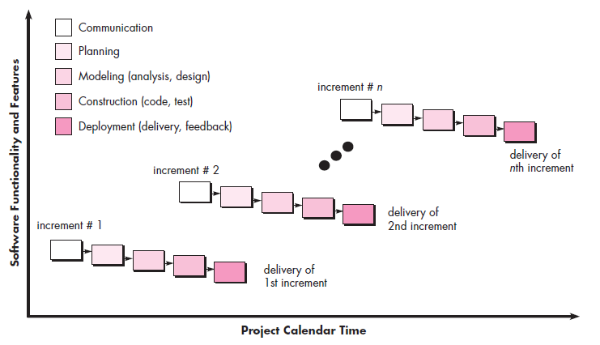
Incremental Process Model
Delivers software in small but usable pieces, each piece builds on pieces already delivered

Slide 20
The Incremental Model
Rather than deliver the system as a single delivery, the development and delivery is broken down into increments with each increment delivering part of the required functionality.
First Increment is often core product
  For Example: Word Processor System
  1st increment: Basic File Management, Editing, Production
  2nd increment: Spell-Checker & Grammar
  3rd increment: Advance Page Layout Properties
  4th increment: Document Printing

Slide 21
The Incremental Model
It is particularly useful when enough staffing is not available for the whole project
Increment can be planned to manage technical risks.
Incremental model focus more on delivery of operational product with each increment.

Slide 22
The Incremental Model
User requirements are prioritised and the highest priority requirements are included in early increments.
Once the development of an increment is started, the requirements are frozen though requirements for later increments can continue to evolve.
Customer value can be delivered with each increment so system functionality is available earlier.

Slide 23
The Incremental Model
Early increments act as a prototype to help elicit requirements for later increments.
Lower risk of overall project failure.
For example, a major system might require the availability of new hardware that is under development and whose delivery date is uncertain.

Slide 24
The End
Thanks for Listening
Questions would be appriciated

